Slide 1

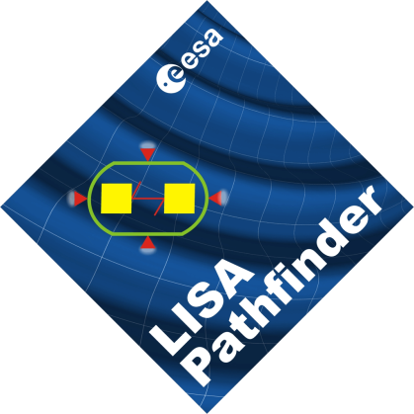



Spacetime metrology with LISA Pathfinder
PhD oral defense
26th March 2012
Giuseppe Congedo
Advisors: | Prof. Stefano Vitale
 | Dr. Mauro Hueller

Slide 2
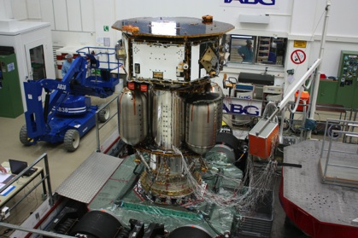
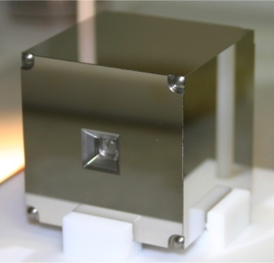
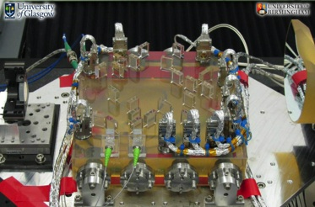
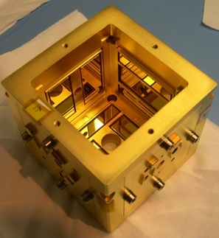
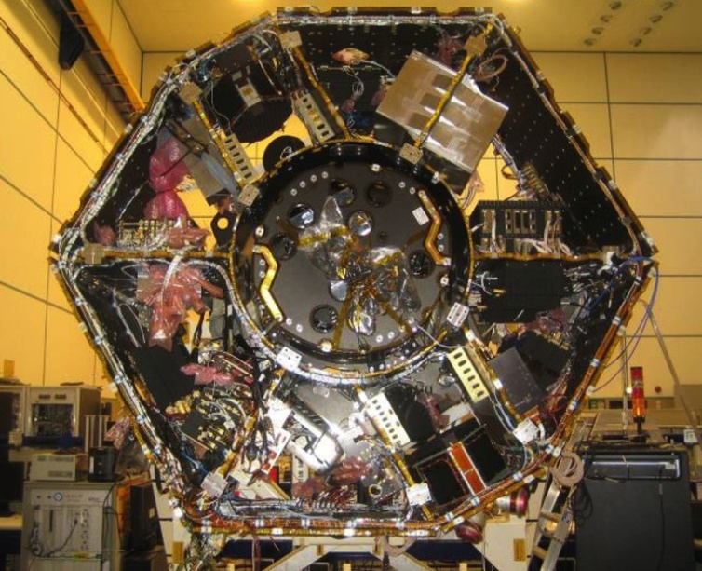

LISA Pathfinder
Test Mass
vibration tests
Optical Bench
Partenership of many universities world wide
Univ. of Trento plays the role of Principal Investigator
Currently in the final integration
Planned to flight in the next years
Housing
courtesy of
SpaceCraft

Slide 3
Outline of the talk
In the framework of this ESA mission, we talk about:
Theoretical characterization of the LISA arm without/with noise
Dynamical modeling for LISA Pathfinder, closed-loop equations of motion
Data analysis: simulation and analysis of some experiments, system calibration, estimation of the acceleration noise, ...

Slide 4
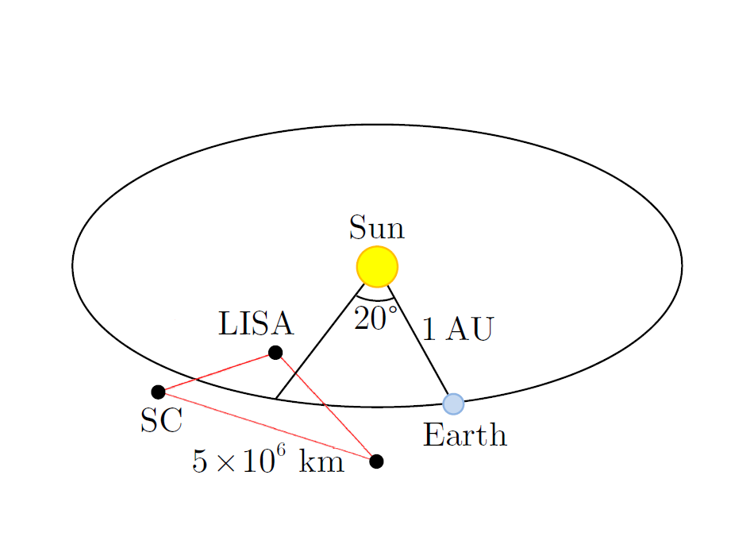
LISA, a space-borne GW detector
LISA is the proposed ESA-NASA mission for GW astrophysics in 0.1 mHz – 0.1 Hz
astrophysical sources at cosmological distances
merger of SMBHs in galactic nuclei
galactic binaries (spatially resolved and unresolved)
EMRIs
GW cosmic background radiation
LISA measures the relative velocities between the Test Masses (TMs) as
Doppler frequency shifts
Test Mass
SpaceCraft (SC)
Optical Bench

Slide 5
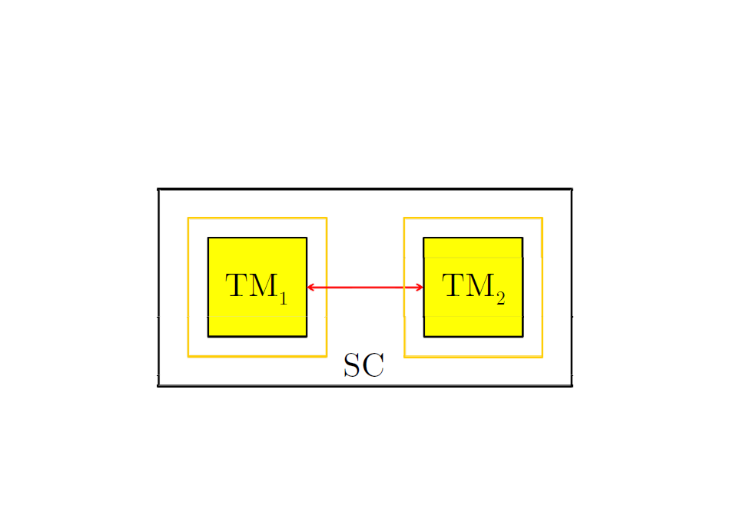
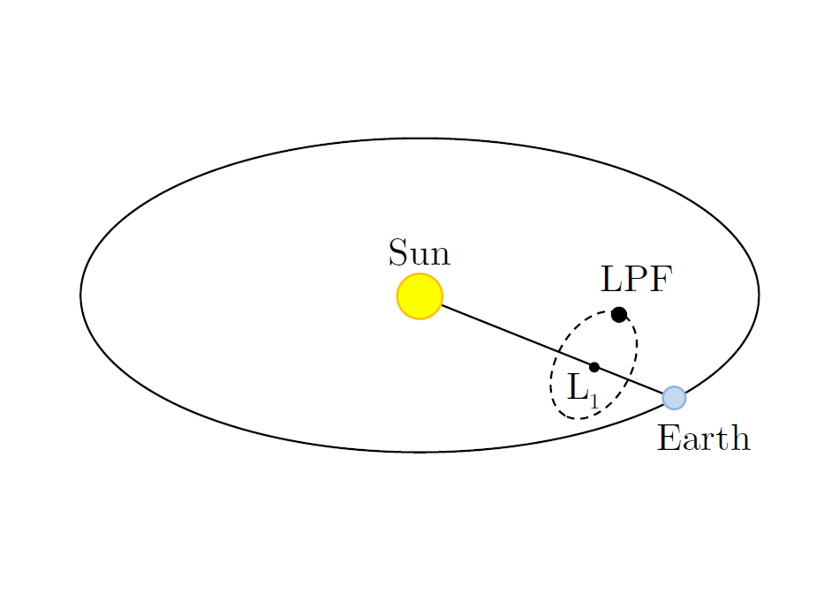
LISA Pathfinder, in-flight test of geodesic motion
Down-scaled version of LISA arm ~40 cm
In-flight test of the LISA hardware (sensors, actuators and controllers)
Prove geodesic motion of TMs to within 3x10⁻¹⁴ ms⁻²/√Hz @1mHz differential acceleration noise requirement
Optically track the relative motion to within 9x10⁻¹² m/√Hz @1mHz differential displacement noise
~40 cm
~5 cm

Slide 6
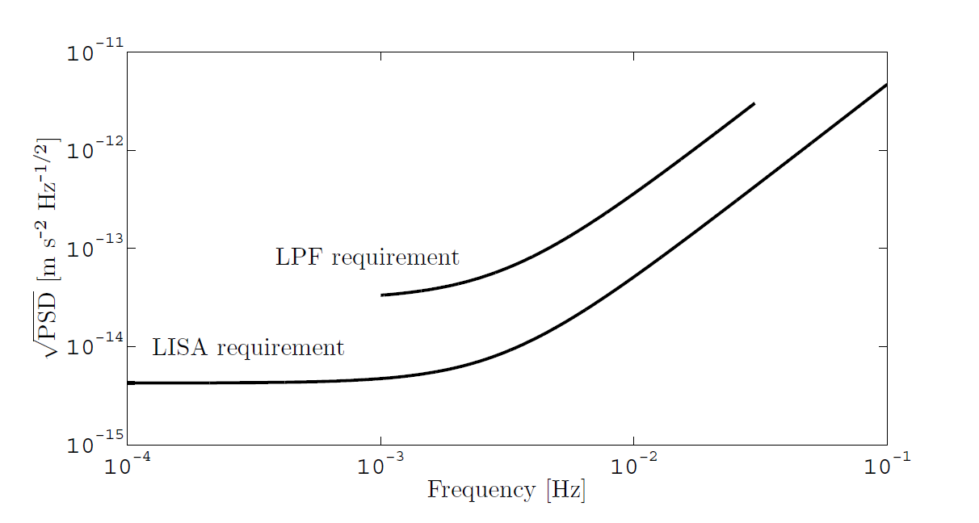
LISA Pathfinder, in-flight test of geodesic motion
Residual acceleration noise
9x10⁻¹² m/√Hz
~ 1 order of magnitude relaxation
3x10⁻¹⁴ ms⁻²/√Hz

Slide 7
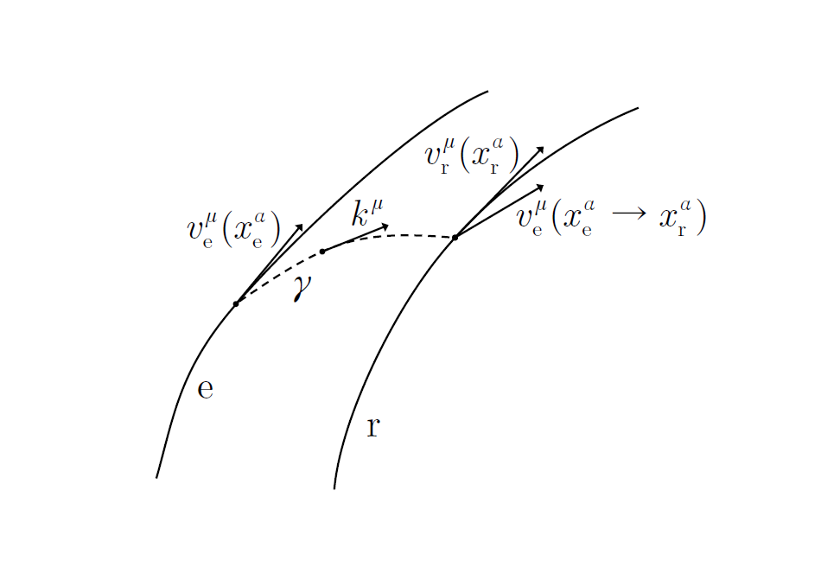


Spacetime metrology without noise
How does the LISA arm work?
It is well-known in General Relativity that the Doppler frequency shift measured between an emitter sending photons to a receiver – we name it Doppler link – is
The differential operator implementing the parallel transport of the emitter 4-velocity along the photon geodesic can be defined as
and one can show that it is given by
The Doppler link measures
relative velocity between the particles (without parallel transport)
the integral of the affine connection (i.e., curvature + gauge effects)

Slide 8



Doppler link as differential accelerometer
For low velocities and along the optical axis, differentiating the Doppler link it turns out
~ω/c (1,1,0,0)
d\dτ
~(c,0,0,0)
to 1st order
The Doppler link (and the LISA arm) can be reformulated as a
differential time-delayed accelerometer
measuring:
The spacetime curvature along the beam
Parasitic differential accelerations
Gauge “non-inertial” effects

Slide 9
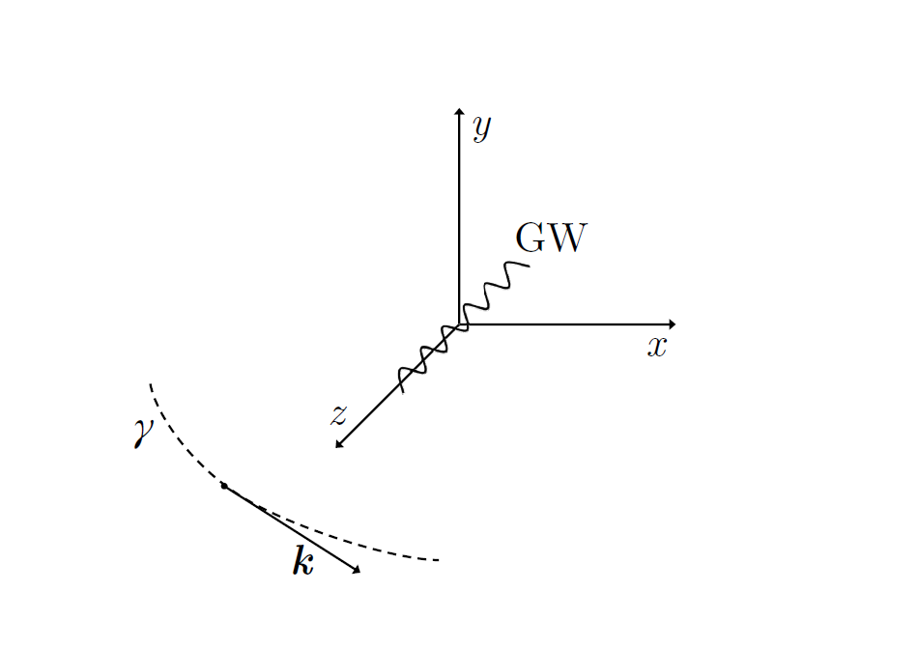
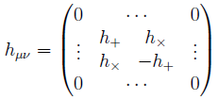

Doppler response to GWs in the weak field limit
To prove that this reasoning is correct, it is possible to evaluate the Doppler response to GWs in the TT gauge
obtaining the standard result already found in literature
where h is the “convolution” with the directional sensitivities and the GW polarizations
The parallel tranport induces a time delay to the time of the emitter

Slide 10
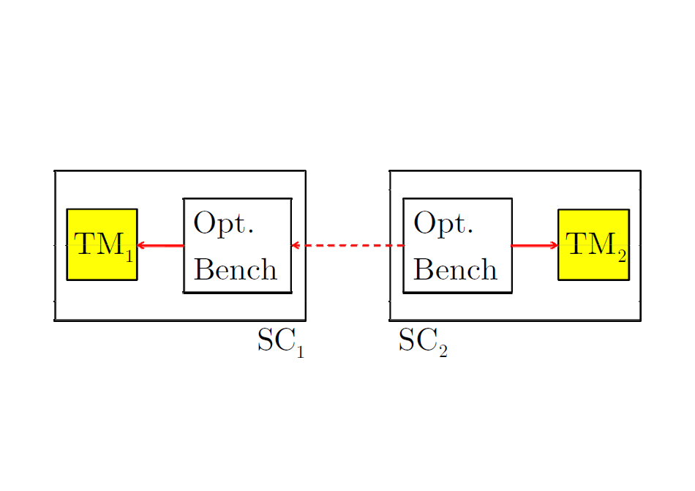


Noise sources within the LISA arm
LPF is a down-scaled version of the LISA arm, which is a sequence of 3 measurements:
In LISA there are 3 main noise sources:
laser frequency noise from armlength imbalances, compensated by TDI, not present in LPF
parasitic differential accelerations, characterized with LPF
sensing noise (photodiode readout), characterized with LPF

Slide 11
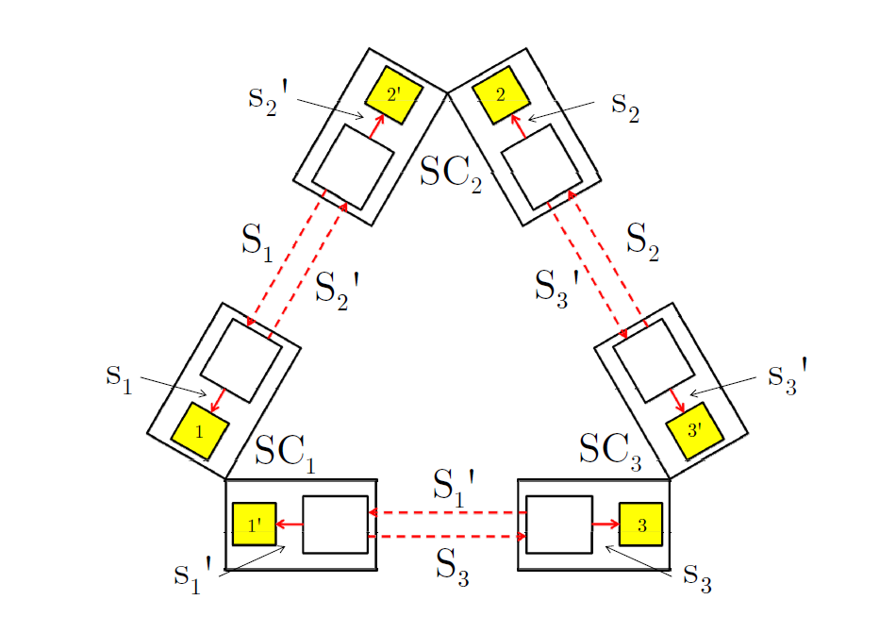

Laser frequency noise
In space, laser frequency noise can not be suppressed as on-ground: arm length imbalances of a few percent produce an unsuppressed frequency noise of
10⁻¹³/√Hz (2x10⁻⁷ ms⁻²/√Hz) @1mHz
σ₁
Doppler links
Time-Delay Interferometry (TDI) suppresses the frequency noise to within
10⁻²⁰/√Hz (2x10⁻¹⁵ ms⁻²/√Hz) @1mHz
It is based upon linear combinations of properly time delayed Doppler links
X₁
σ₁'

Slide 12
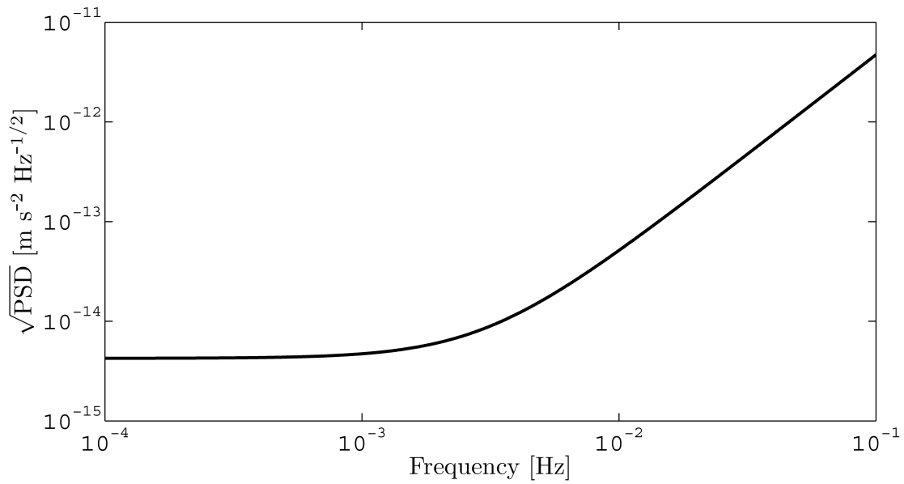

Total equivalent acceleration noise
Differential forces (per unit mass) between the TMs, due to electromagnetics & self-gravity within the SC,
Sensing noise (readout, optical bench misalignments),
We can express all terms as total equivalent acceleration noise
will be demonstrated by LPF to be within 3x10⁻¹⁴ ms⁻²/√Hz @1mHz
total equivalent acceleration noise
sensing
forces

Slide 13
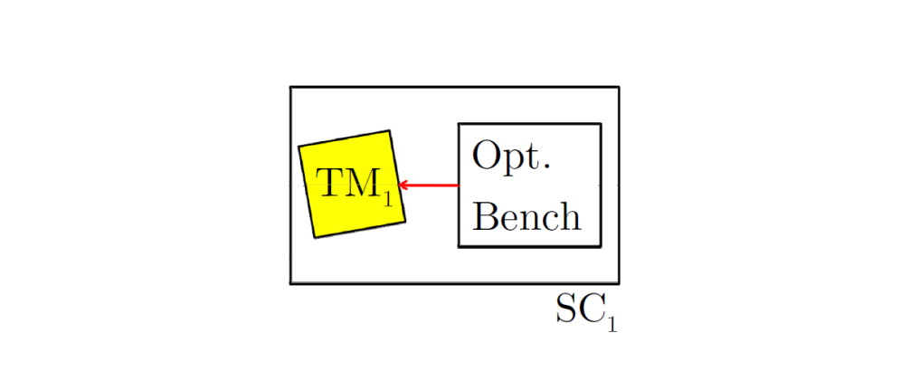
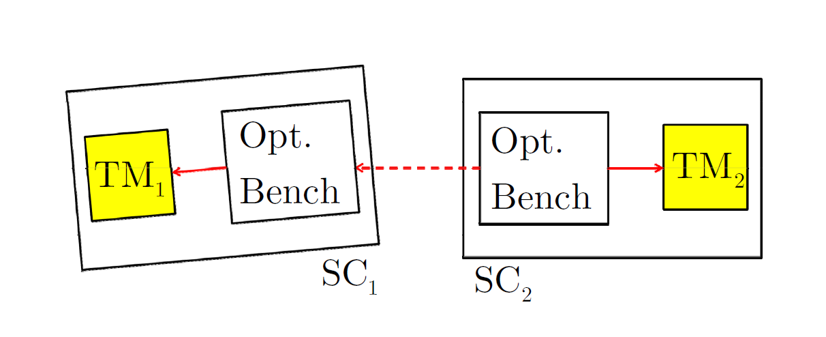
Dynamics of fiducial points
Fiducial points are the locations on TM surface where light reflects on
They do not coincide with the centers of mass
As the TMs are not pointlike, extended body dynamics couples with the differential measurement (cross-talk)
Local link
Link between the SCs

Slide 14
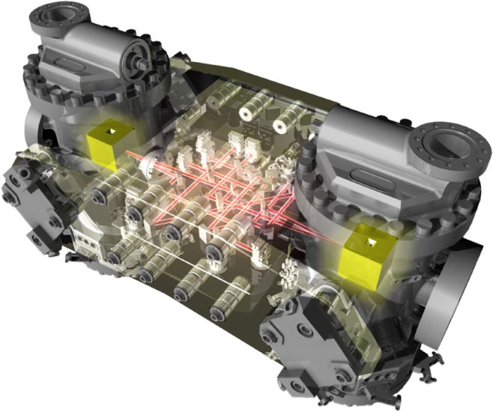
LISA Technology Package
We switch to the real instrument...
15 control laws are set up to minimize:
SC jitter and differential force disturbances

Slide 15
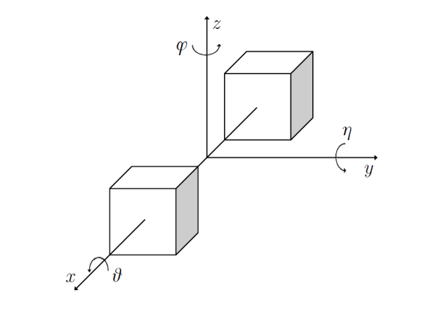
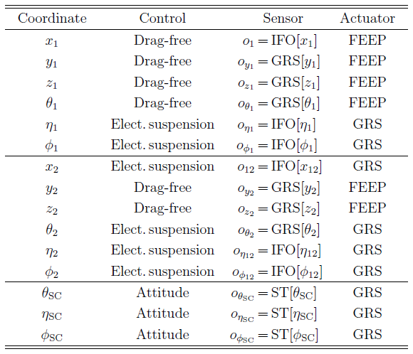
Degrees of freedom
Science mode, along the optical axis x:
TM₁ is in free fall
the SC is forced to follow TM₁ through thruster actuation
TM₂ is forced to follow TM₁ through capacitive actuation

Slide 16
Closed-loop dynamics
In LPF dynamics:
the relative motion is expected to be within ~nm
we neglect non-linear terms from optics and extended body Euler dynamics
the forces can be expanded to linear terms
Since the linearity of the system, it follows that the equations of motion are linear, hence in frequency domain they can be expressed in matrix form (for many dofs)
Dynamics operator

Slide 17
Closed-loop dynamics
As said, the equations of motion are linear and can be expressed in matrix form
Dynamics
“forces produce the motion”
Sensing
“positions are sensed”
Control
“noise, actuation and control forces”
The generalized equation of motion in the sensed coordinates
where the 2nd-order differential operator is defined by

Slide 18
Dynamical model along the optical axis
direct forces on TMs and SC
force gradients
guidance signals: reference signals that the controllers must follow (“the loops react”)
sensing cross-talk
actuation gains

Slide 19
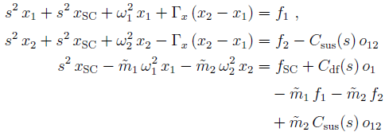





Dynamical model along the optical axis
The model along x can be mapped to the matrix formalism...

Slide 20
Two operators
The differential operator
estimates the out-of-loop equivalent acceleration from the sensed motion
subtracts known force couplings, control forces and cross-talk
subtracts system transients
The transfer operator
solves the equation of motion for applied control bias signals
is employed for system calibration, i.e. system identification

Slide 21

Suppressing system transients
The dynamics of LPF (in the sensed coordinates) is described by the following linear differential equation
Particular solution (steady state):
depends on the applied forces
can be solved in frequency domain
Homogeneous solution (transient state):
depends on non-zero initial conditions
is a combination of basis functions

Slide 22

Suppressing system transients
Applying the operator on the sensed coordinates, transients are suppressed in the estimated equivalent acceleration
But, imperfections in the knowledge of the operator (imperfections in the system parameters) produce systematic errors in the recovered equivalent acceleration
System identification helps in mitigating the effect of transients

Slide 23
Cross-talk from other degrees of freedom
Beyond the dynamics along the optical axis...
cross-talk from other DOFs
nominal dynamics along x
All operators can be expanded to first order as “imperfections” to the nominal dynamics along x
To first order, we consider only the cross-talk from a DOF to x, and not between other DOFs.
Cross-talk equation of motion

Slide 24
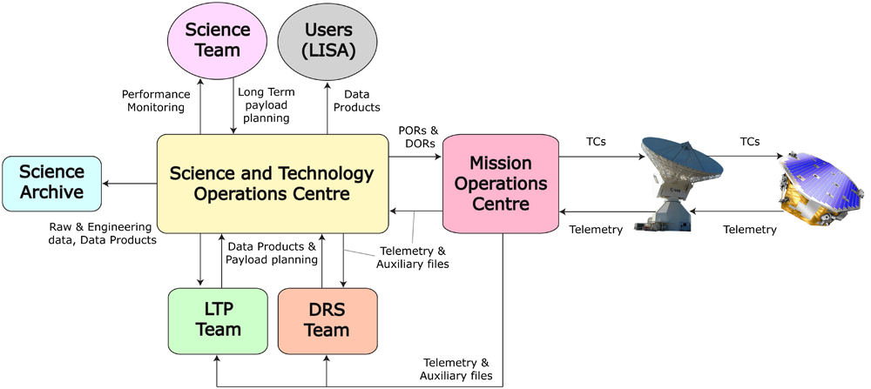
Data analysis during the mission
The Science and Technology Operations Centre (STOC):
interface between the LTP team, science community and Mission Operations
telecommands for strong scientific interface with the SpaceCraft
quick-look data analysis

Slide 25
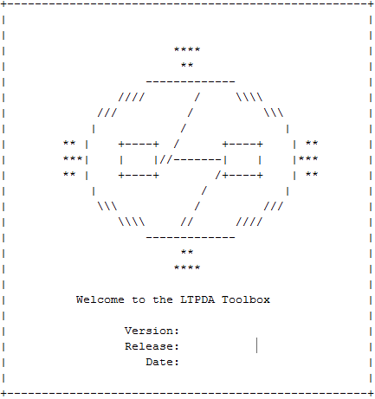
Data analysis during the mission
Data for this thesis were simulated with both analytical simplified models and the Off-line Simulation Environment – a simulator provided by ASTRIUM for ESA.
It is realistic as it implements the same controllers, actuation algorithms and models a 3D dynamics with the couplings between all degrees of freedom
During operational exercises, the simulator is employed to:
check the mission timeline and the experiments
validate the noise budget and models
check the procedures: system identification, estimation of equivalent acceleration, etc.
Data were analyzed with the LTP Data Analysis Toolbox – an object-oriented Matlab environment for accountable and reproducible data analysis.
initial splash screen

Slide 26
Multi-input/Multi-Output analysis
o_{i,1}
We are able to recover the information on the system by stimulating it along different inputs
o_{i,12}
o₁
f_{i,1}
LPF dynamical system
o₁₂
f_{i,12}
f_{i,SC}
...
...
In this work two experiments were considered allowing for the determination of the system:
Exp. 1: injection into drag-free loop
Exp. 2: injection into elect. suspension loop

Slide 27
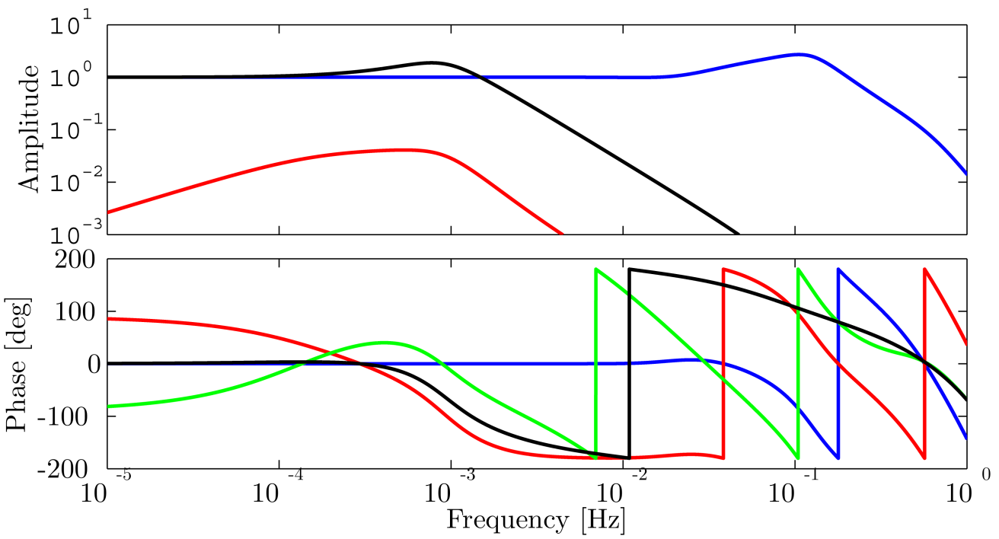
LPF model along the optical axis
For simulation and analysis, we employ a model along the optical axis
Transfer matrix (amplitude/phase) modeling the system response to
applied control guidance signals
“the spacecraft moves”: drag-free loop
“the second test mass moves”: suspension loop
cross-talk

Slide 28
LPF parameters along the optical axis
Parameter | Typical value | Description
 | -1x10⁻⁶ s⁻² | Parasitic stiffness constant: force gradient (per unit mass) between the TM and the SC
 | <1x10⁻⁶ s⁻² | Differential parasitic stiffness constant: force gradient (per unit mass) between the TMs
 | 1x10⁻⁴ | sensing cross-talk from o₁ to o₁₂
 | 1 | thruster actuation gain: how forces on SC translate into real applied forces
 | 1 | capacitive actuation gain: how forces on TM₂ translate into real applied forces
 | <1 s | delay in the application of the o₁ control bias
 | <1 s | delay in the application of the o₁₂ control bias

Slide 29
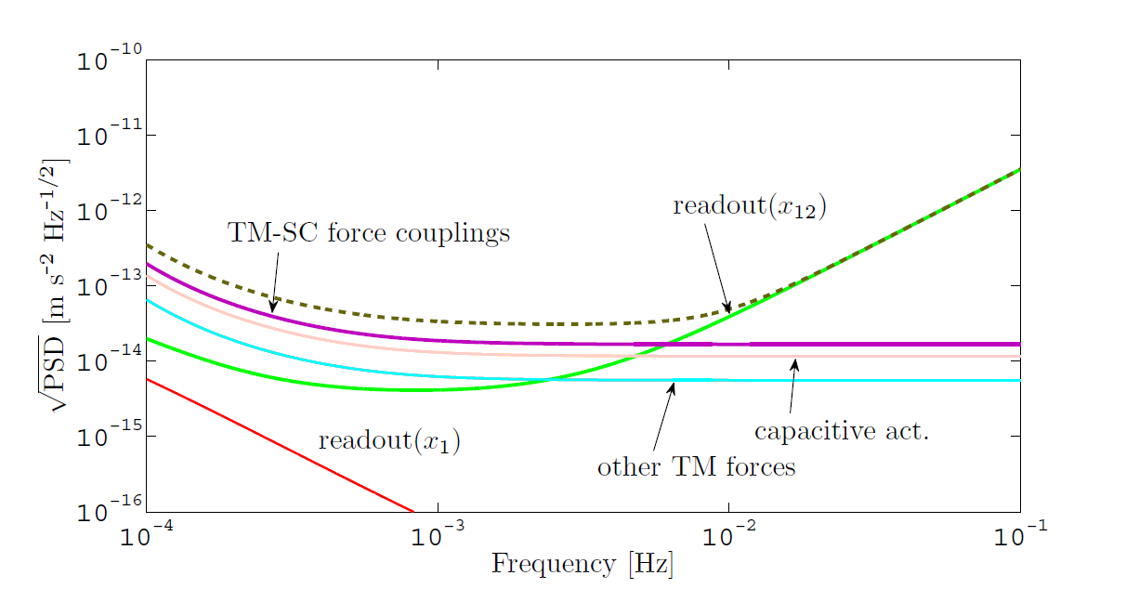
Equivalent acceleration noise
Relative acceleration between the TMs
Current best estimates of the direct forces from on-ground measurements
Diff. acc. source | x10⁻¹⁴ ms⁻²/√Hz
Actuation | 0.75
Brownian | 0.72
Magnetics | 0.28
Stray voltages | 0.11
at high frequency, dominated by sensing
at low frequency, dominated by direct forces
Goal: prove the relevance of system identification for the correct assessement of the equivalent acceleration noise

Slide 30
Estimation of equivalent acceleration noise
system identification
optimal design
with system identification
parameters
ω₁², ω₁₂², S₂₁, A_{df}, ...
equivalent acceleration
sensed
relative motion
o₁, o₁₂
diff. operator
Δ
without system identification

Slide 31
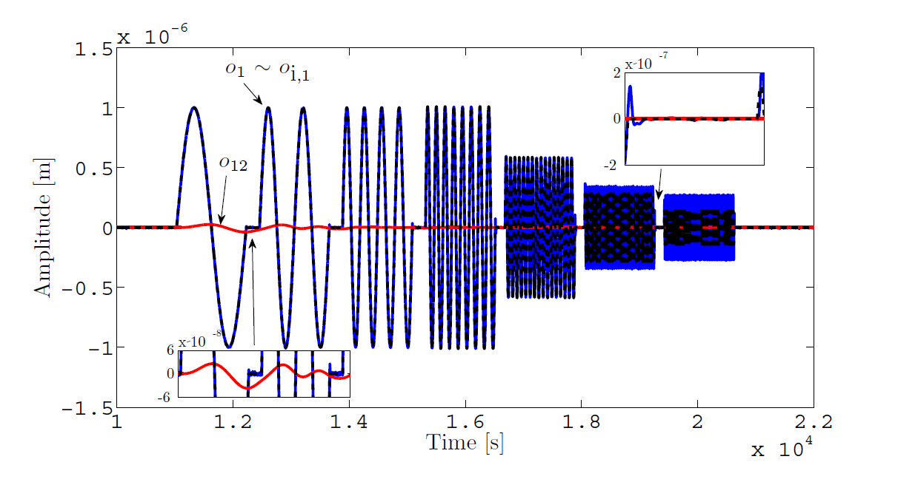
Identification experiment #1
Exp. 1: injection of sine waves into o_{i,1}
injection into o_{i,1} produces thruster actuation
o₁₂ shows dynamical cross-talk of a few 10⁻⁸ m
allows for the identification of: A_{df}, ω₁², Δt₁

Slide 32
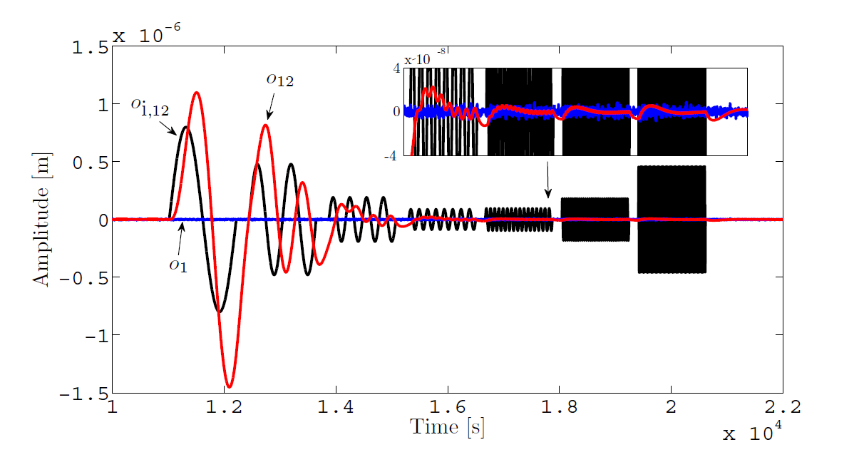
Identification experiment #2
Exp. 2: injection of sine waves into o_{i,12}
injection into o_{i,1} produces capacitive actuation on TM₂
o₁ shows negligible signal
allows for the identification of: A_{sus}, ω₁₂², Δt₂, S₂₁

Slide 33

Parameter estimation
Non-linear optimization:
preconditioned conjugate gradient search explores the parameter space to large scales
derivative-free simplex improves the numerical accuracy locally
Method extensively validated through Monte Carlo simulations
Joint (multi-experiment/multi-outputs) log-likelihood for the problem
cross-PSD matrix
residuals

Slide 34
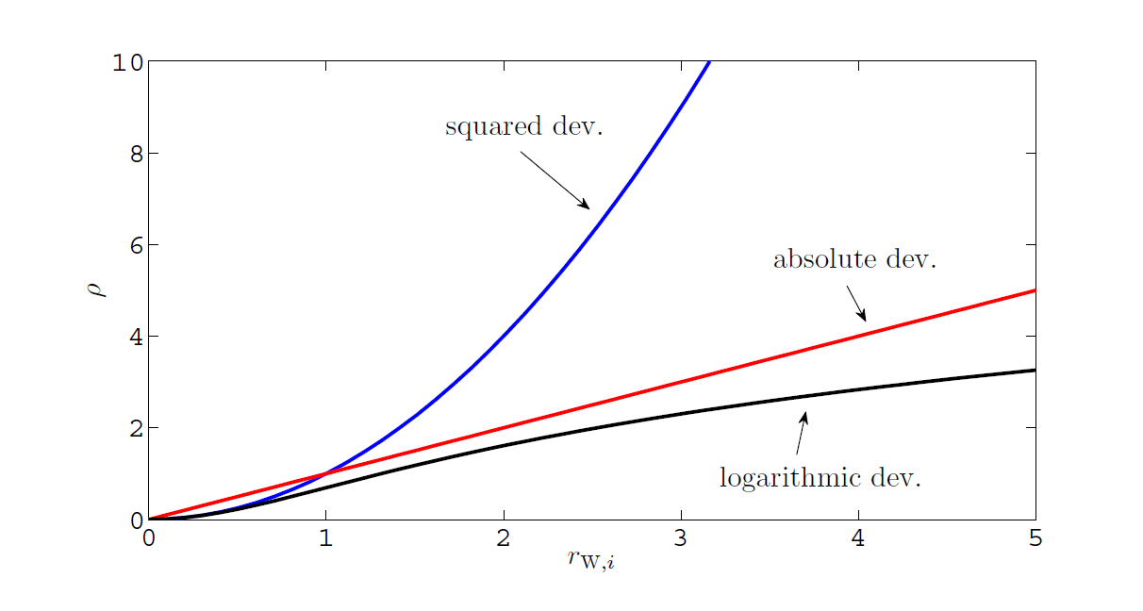


Non-Gaussianities
Investigated the case of non-gaussianities (glitches) in the readout producing fat tails in the statistics (strong excess kurtosis)
Better weighting for large deviations than squared and abs dev.
Regularize the log-likelihood with a weighting function
mean squared dev. (aka, “ordinary least squares”), Gaussian distr.
abs. deviation, log-normal distr.
log. deviation, Lorentzian distr.

Slide 35
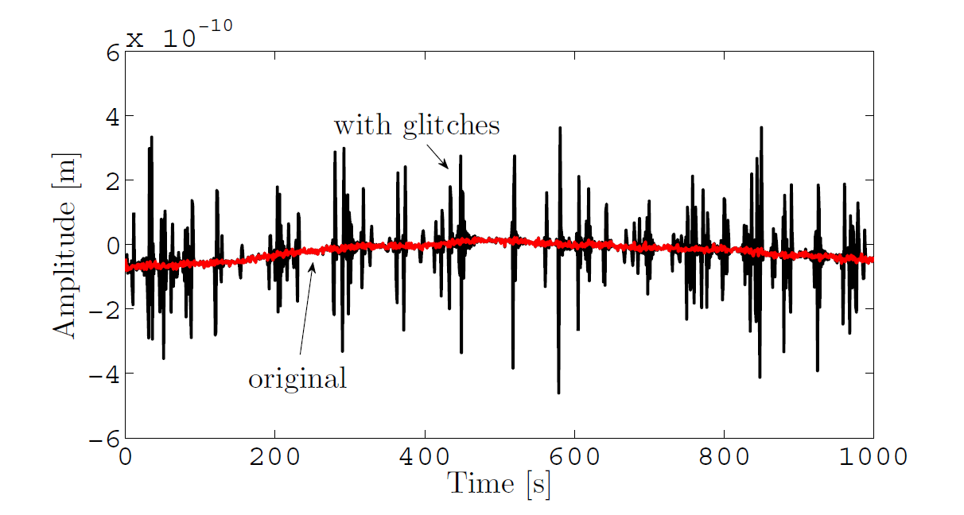
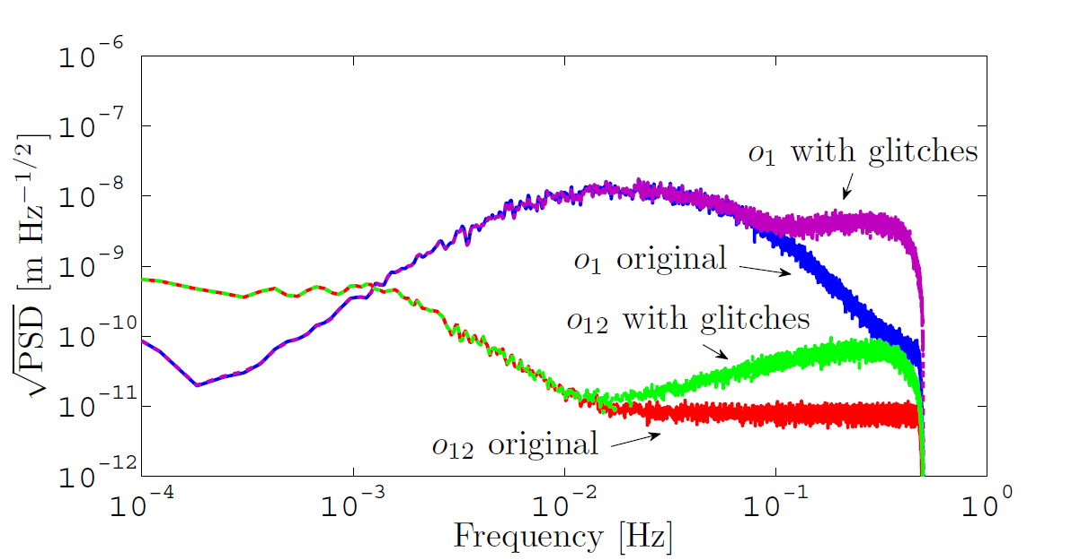
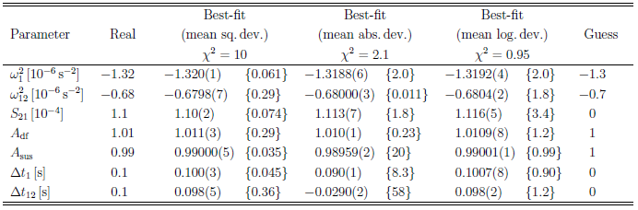
Non-Gaussianities
o₁₂
χ² regularizes toward ~1
the parameter bias, in average, tends to <3

Slide 36
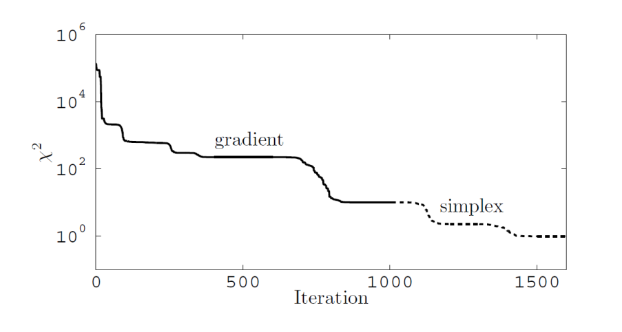
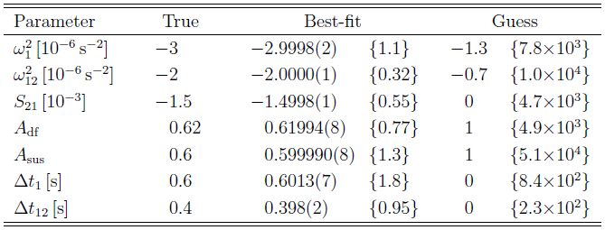
Under-performing actuators under-estimated couplings
Investigated the case of a miscalibrated LPF mission, in which:
the TM couplings are stronger than one may expect
the (thruster and capacitive) actuators have an appreciable loss of efficiency
The parameter bias reduces from 10³-10⁴ σ to <2 and
the χ² from ~10⁵ to ~1

Slide 37
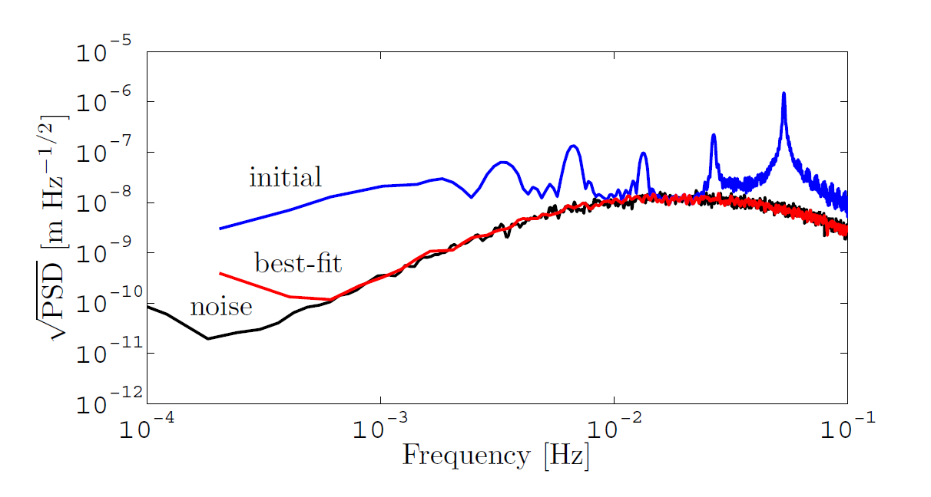
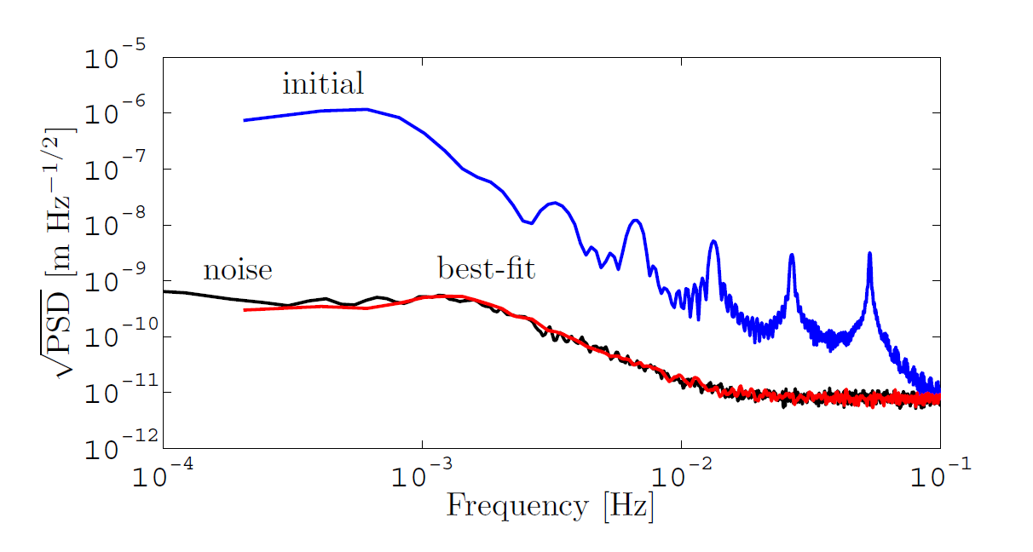
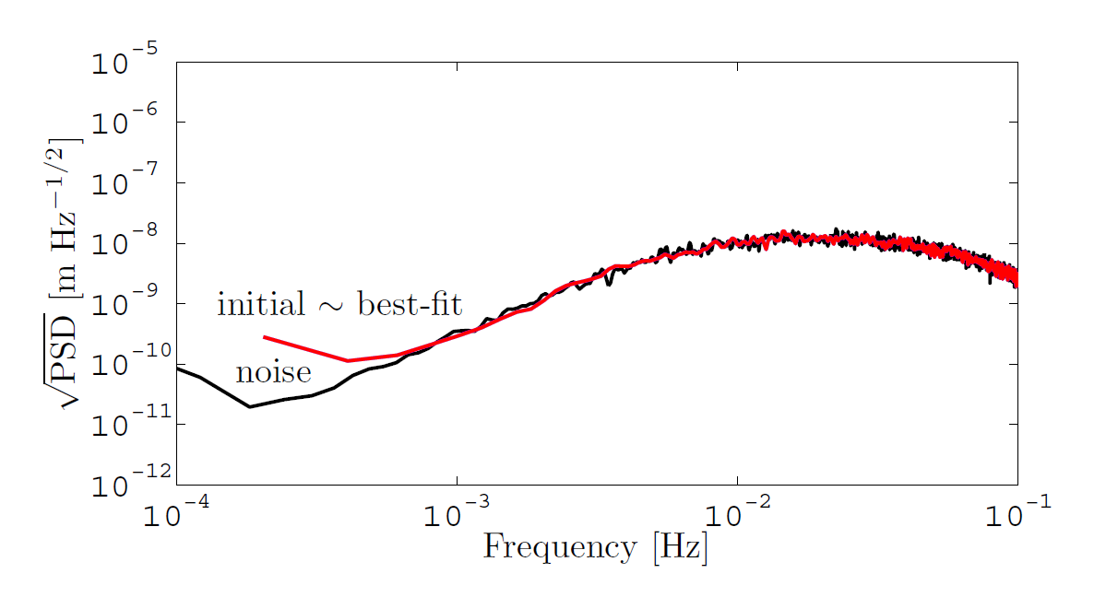
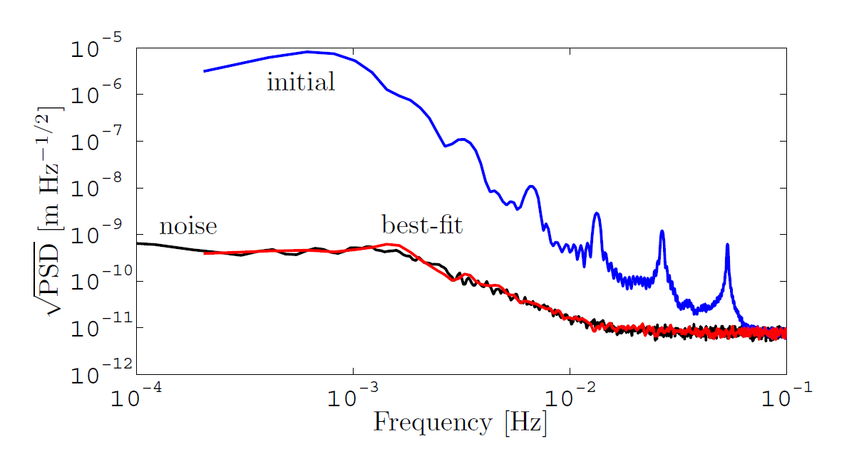
Under-performing actuators under-estimated couplings
Exp. 1 residuals
~2 orders of
magnitude
~3 orders of
magnitude
Exp. 2 residuals

Slide 38
Equivalent acceleration noise
Inaccuracies in the estimated system parameters produce systematic errors in recovered equivalent acceleration noise
PSD matrix of the sensed relative motion
inaccuracies of the diff. operator
“true” diff. operator, as with the perfect knowledge of the system
systematic errors in the estimated equivalent acceleration noise
Perform an estimation of the equivalent acceleration noise in a miscalibrated LPF mission (as in the previous example):
without a system identification (@ initial guess)
with a system identification (@ best-fit)
with the perfect knowledge of the system (@ true)

Slide 39
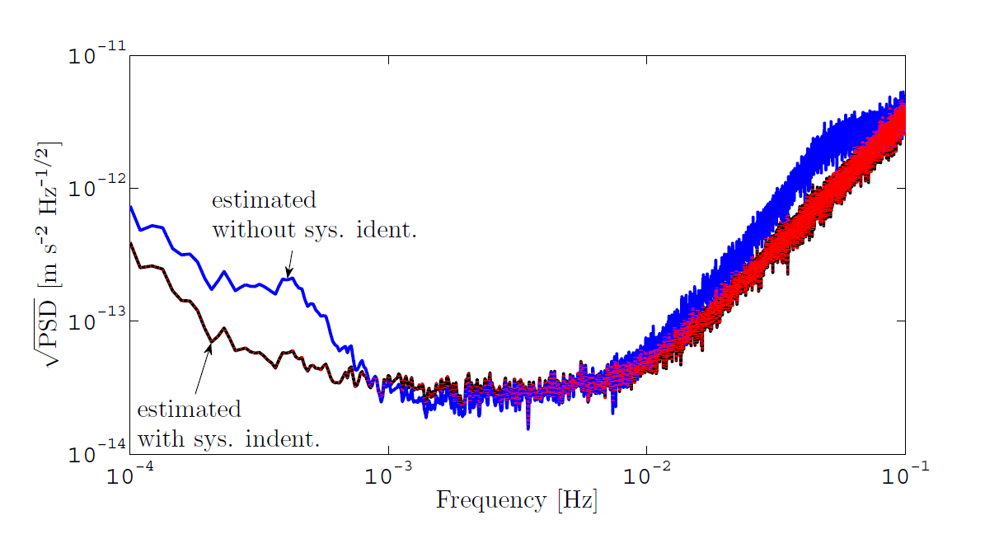
Equivalent acceleration noise
Estimated differential acceleration noise
Blue: estimated without sys. ident.
Dashed red: estimated with sys. ident.
Black: “true” shape
Δa~1.5x10⁻¹³ m s⁻² Hz^{-1/2}
Thanks to system identification:
the estimated acceleration recovers the “true” shape
improvement of a factor ~2 around 50 mHz
improvement of a factor ~4 around 0.4 mHz

Slide 40
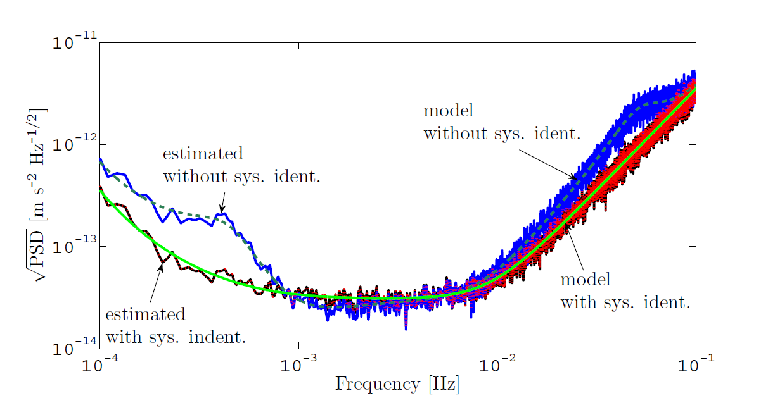
Equivalent acceleration noise
Estimated differential acceleration noise and models
Dashed green: estimated model without sys. ident.
Solid green: estimated model with sys. ident.
Solid black: “true” model
Δa~1.5x10⁻¹³ m s⁻² Hz^{-1/2}
The agreement between estimated noise and models shows:
the models explain the estimated acceleration spectra
the accuracy of the noise generation

Slide 41
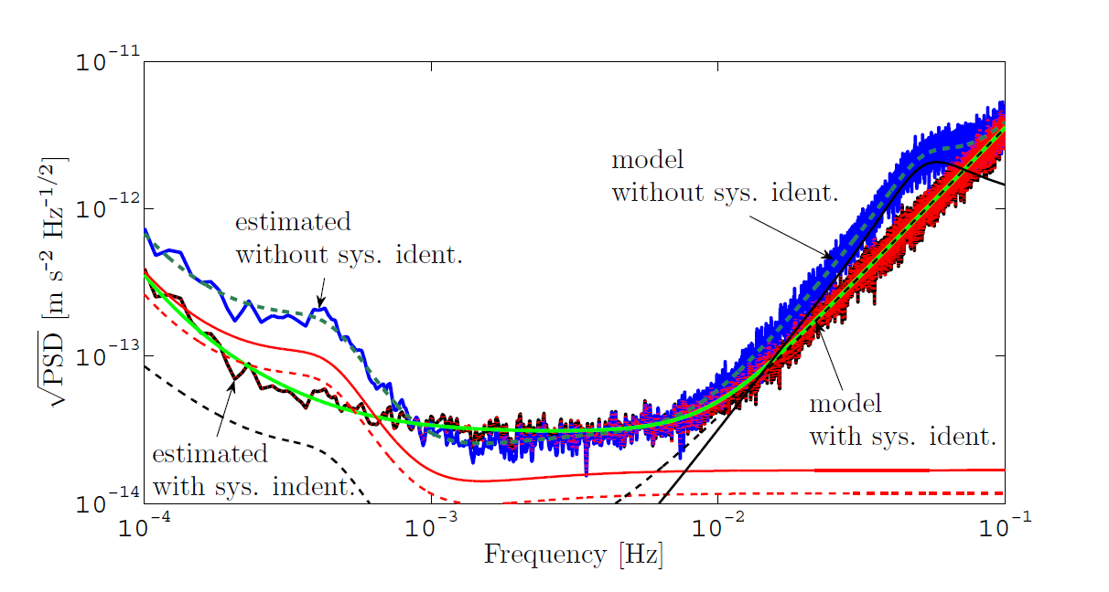
Equivalent acceleration noise
Estimated differential acceleration noise and models
plus fundamental sources
Solid red: TM-SC coupling forces
Dashed red: capacitive actuation noise
Solid black: thruster actuation noise
Dashed black: o₁₂ sensing noise
Δa~1.5x10⁻¹³ m s⁻² Hz^{-1/2}
The systematic errors are due to:
0.4 mHz, uncalibrated coupling forces (ω₁² and ω₂²) and capacitive actuation (A_{sus})
50 mHz, uncalibrated thruster actuation (A_{df}) and sensing noise (S₂₁)

Slide 42
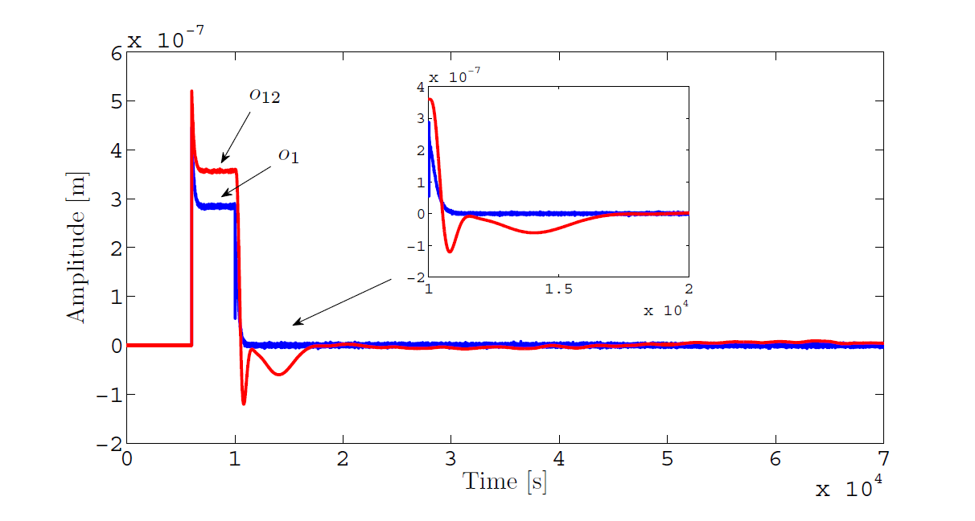
Suppressing transients in the acceleration noise
As a consequence of changes of state and non-zero initial conditions, the presence of transients in the data is an expected behavior.
Transients last for about 2 hours in o₁₂

Slide 43
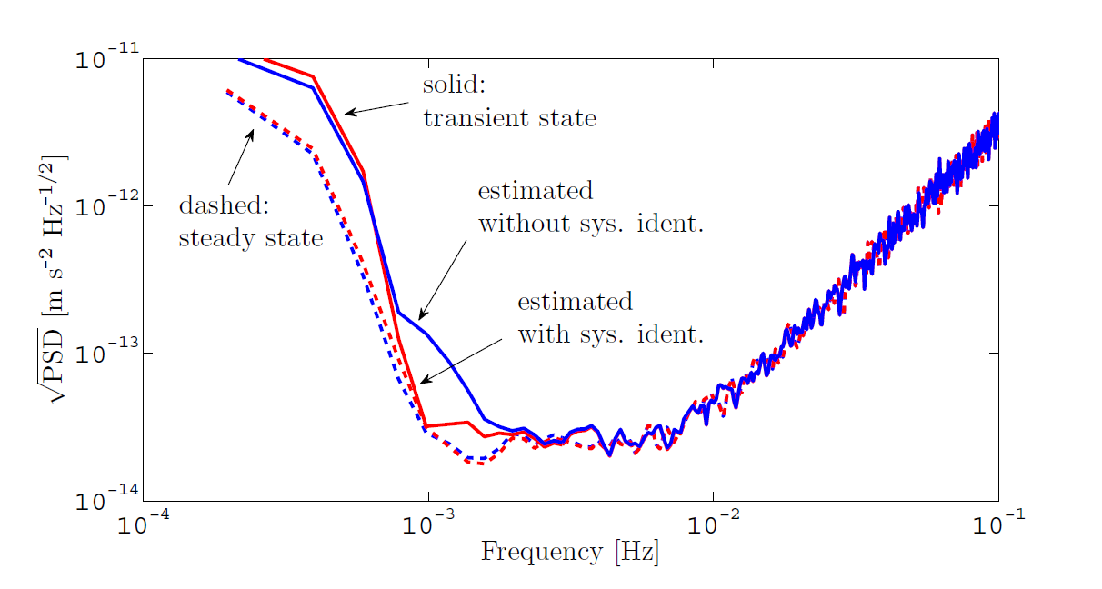
Suppressing transients in the acceleration noise
Comparison:
(i) between the acceleration estimated at the transitory (first 3x10⁴ s) and steady state;
(ii) between the acceleration estimated without and with system identification
Dashed: steady state
Solid: transitory
Blue: without sys. ident.
Red: with sys. ident.
Data simulated with ESA simulator: suppression is not perfect since the limitation of the model
System identification helps in mitigating the transitory in the estimated acceleration noise

Slide 44

Design of optimal experiments
Goal: find optimal experiment designs allowing for an optimal determination of the system parameters
The LPF experiments can be optimized within the system contraints:
shape of the input signals
sensing range of the interferometer 100 µm
thruster authority 100 µN
capacitive authority 2.5 nN
input signals: series of sine waves with discrete frequencies (we require integer number of cycles)
T < 3h (experiment duration): fixed
N_{inj} = 7: fixed to meet the exp. duration
δt = 1200 s (duration of each sine wave): fixed
δt_{gap} = 150 s (gap between two sine waves): fixed for transitory decay
f_{n} (injection freq.): optimized
a_{n} (injection ampl.): varied according to f_{n} and the (sensing/actuation) contraints

Slide 45
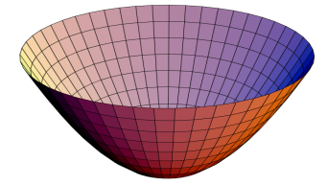


Design of optimal experiments
Fisher information matrix
noise cross PSD matrix
input parameters
(injection frequencies)
estimated
system parameters
input signals
being optimized
modeled transfer matrix with system identification
Perform (non-linear discrete) optimization of the scalar estimator
optimization criteria
minimizes
“covariance volume”

Slide 46
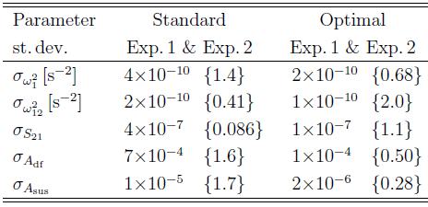
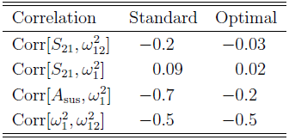
Design of optimal experiments
With the optimized design:
Improvement in precision:
factor 2 for ω₁² and ω₁₂²
factor 4 for S₂₁
factor 5-7 for A_{sus}, A_{df} : important for compensating the SC jitter
Some parameters show lower correlation than the standard experiments
The optimization converged to only two injection frequencies (0.83 mHz, 50 mHz)

Slide 47
Concluding remarks
Theoretical contribution to the foundations of spacetime metrology with the LPF differential accelerometer
Modeling of the dynamics of the LISA arm implemented in LPF
Development of the parameter estimation method employed for system calibration and subtraction of different effects
Relevance of system identification for LPF

Slide 48
Future perspectives
More investigation in the reformulation of the Doppler link as a differential accelerometer
Application of system identification to the analysis of some cross-talk experiments
Investigation of non-stationary (transient) components in the noise
Application of the proposed optimal design to the ESA simulator
Currently under investigation, the application of system identification in the domain of equivalent acceleration

Slide 49
Thanks for your attention!

Slide 50
Additional slides...

Slide 51
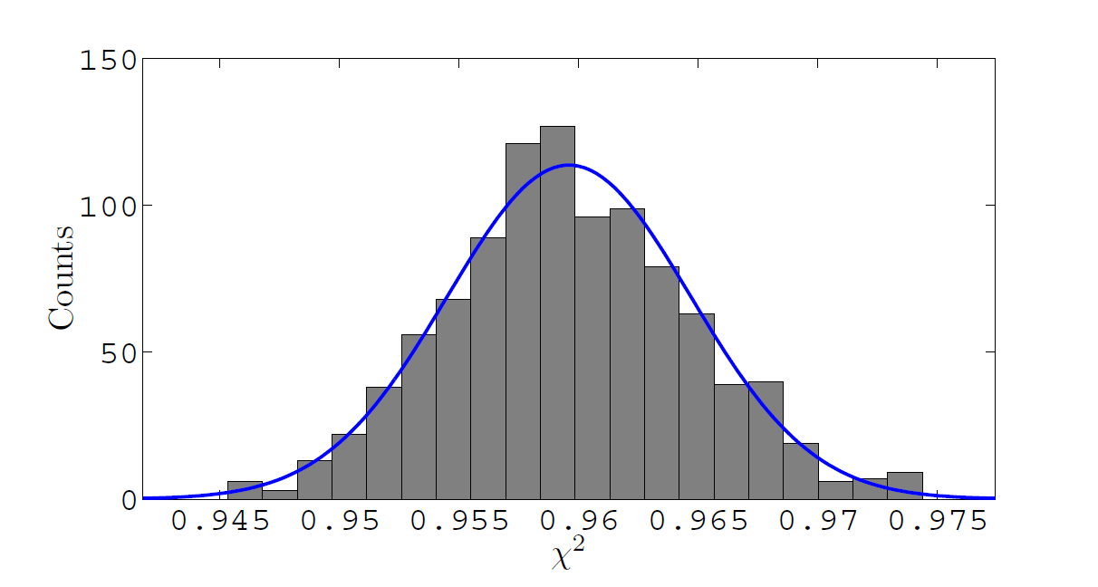
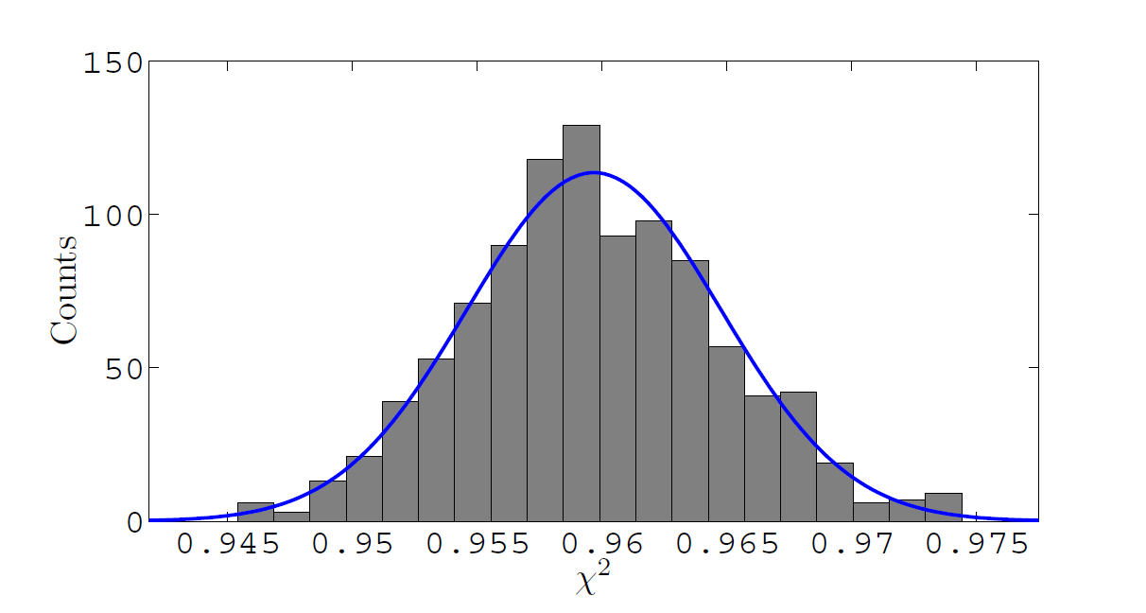
Monte Carlo validation
fit log-likelihood
noise log-likelihood
1000 noise realizations, true (7) parameters kept fixed
all parameters are in good agreement with a Gaussian PDF, as well as correlations and variances
parameters are unbiased to within 1-2 standard deviations
expected (Fisher) errors are approximately in agreement with the noise fluctuation
the method statistically suppresses the signals (see above)

Slide 52
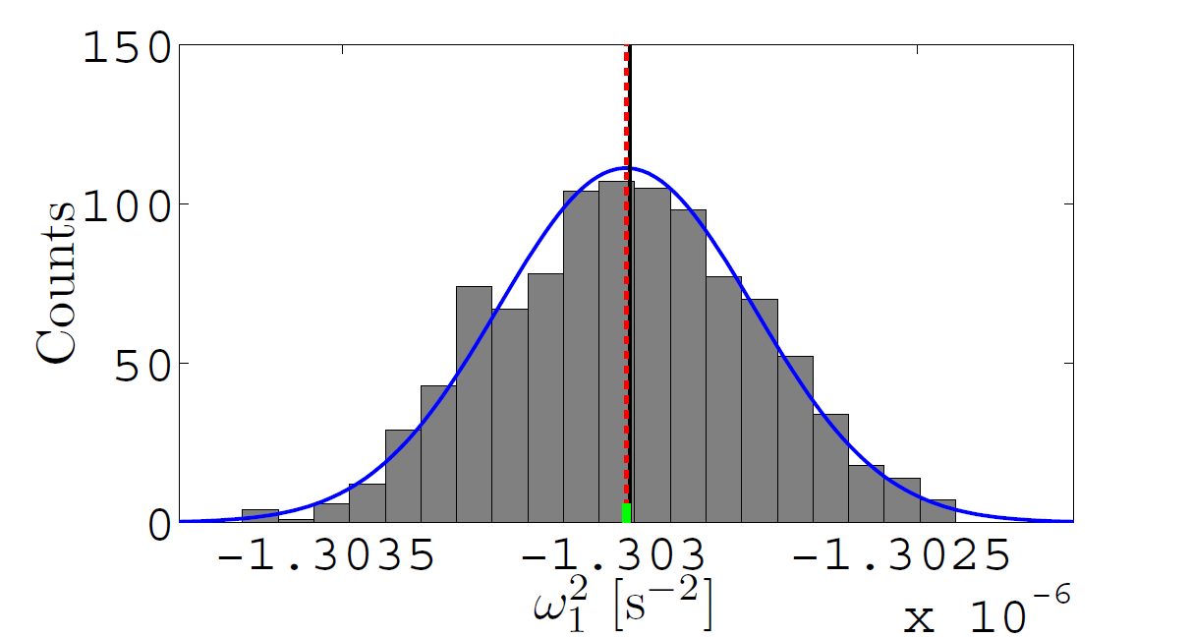
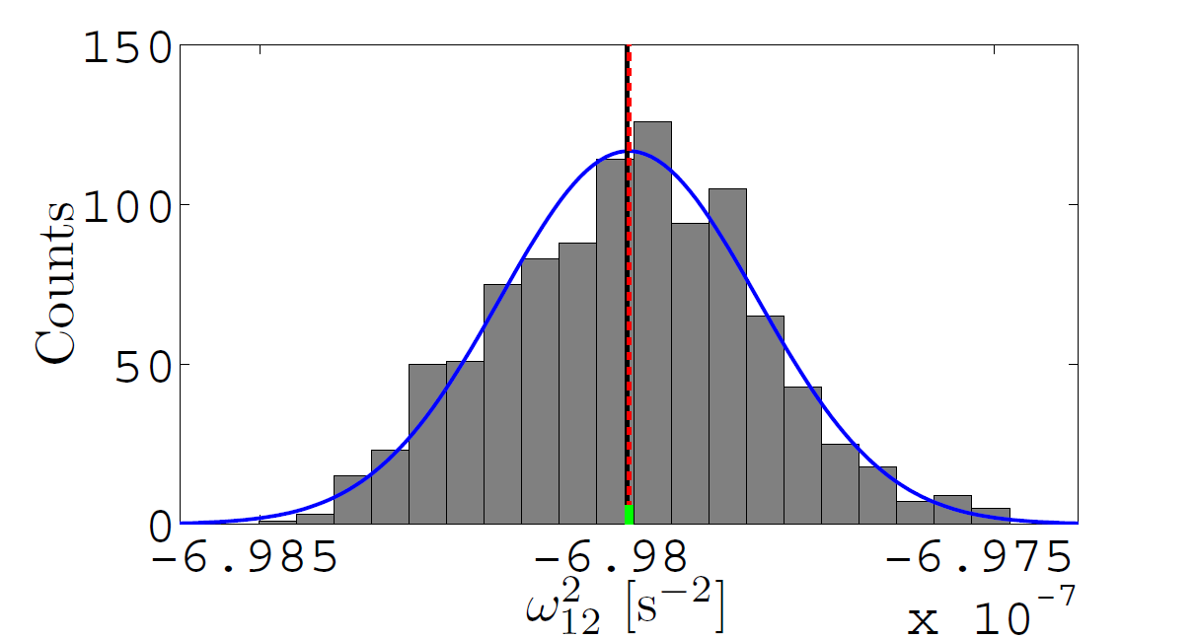


Monte Carlo validation

Slide 53

Whitening
System identification relies upon a proper estimation of whitening filters

Slide 54


Design of optimal experiments
o_{i,1} inj.
o_{i,12} inj.
For almost the entire frequency band, the maximum amplitudes are limited by the interferometer sensing

Slide 55

Identification in the acceleration domain
Comment: formally equivalent to standard identification in displacement, but the transitory is mitigated in equivalent acceleration.
Implementation: closed-loop optimization where the parameters enter into the estimated acceleration

Slide 56


Transient analysis
injected a (Gaussian) force signal of amplitude 1.6x10⁻¹³ ms⁻² and duration ~1 h
PSD estimation does not detect any (statistically significant) excess
time-frequency wavelet spectrogram: a factor >2 noise excess
can be applied to the search of transients in LPF noise, like “modified gravity” signals

